Slide 1
EXPLORE NEW YORK

Slide 2
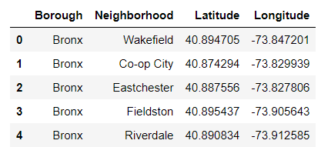
Collect the Data

Slide 3
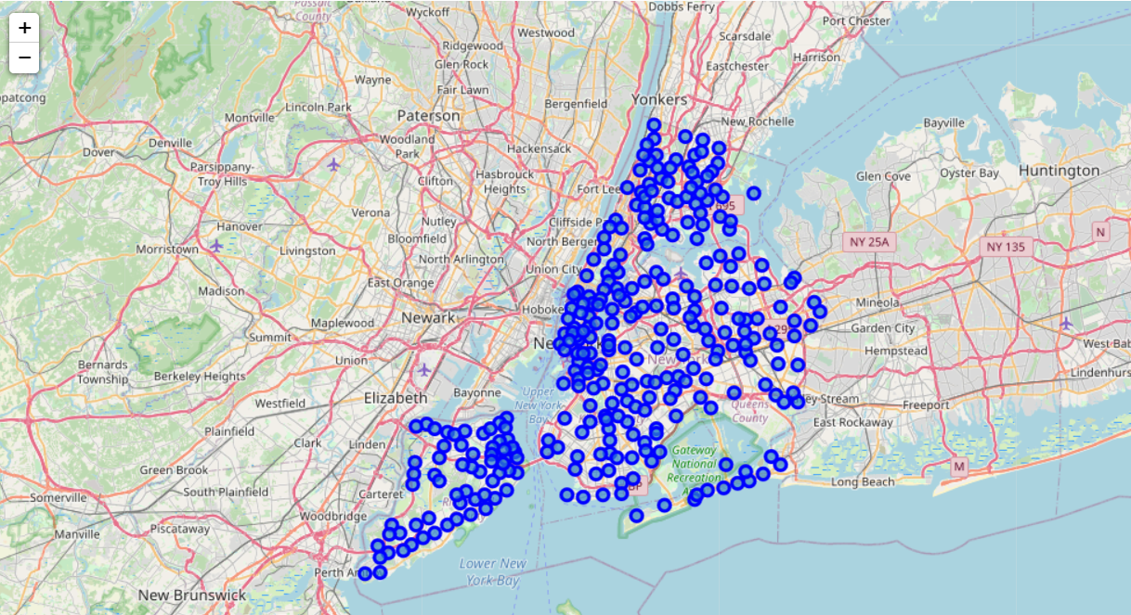
Map of New York with Neighbourhoods

Slide 4
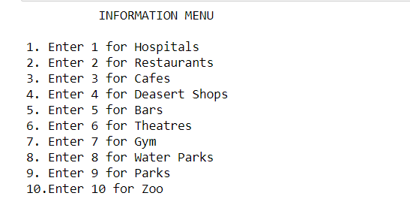
The Menu for the user

Slide 5
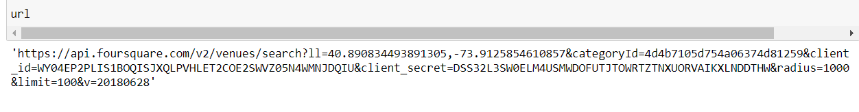
The URL for the Foursquare API

Slide 6
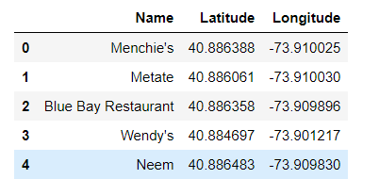
The data retrieved from the API

Slide 7
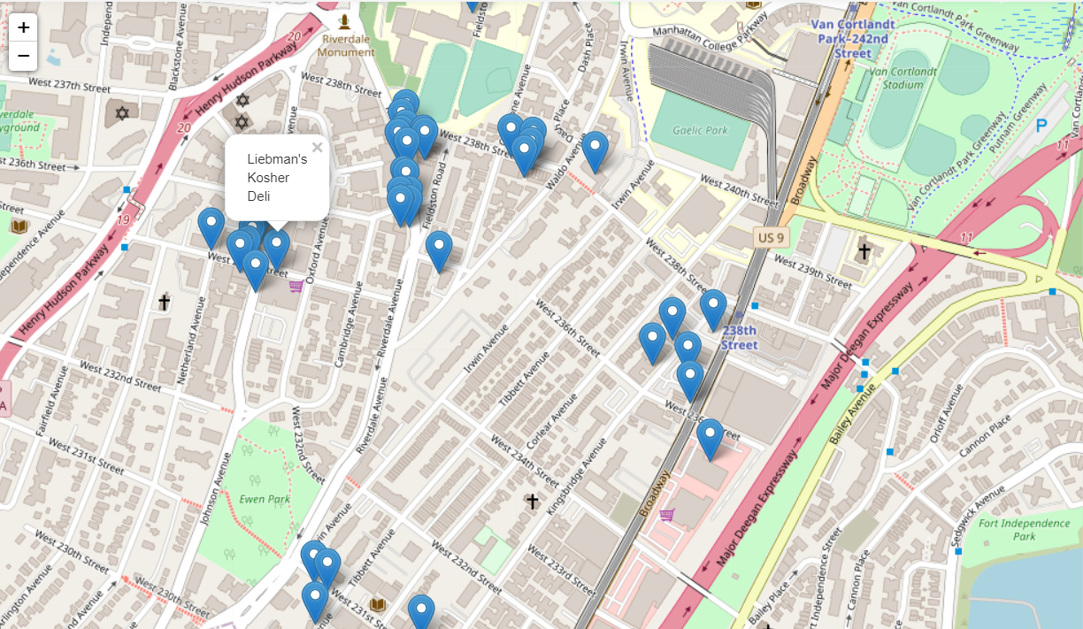
The Map with the venues plotted on it.

Slide 8
THANK YOU

